Slide 1
Project 3: Geo-location Clustering in SPARK
Adrien Xie, Ziqian Luo,

Slide 2
Team Members
James Chen as Project Manager
Ziqian Luo as developer local
Adrien Xie as developer cloud
Jason Zhu as Key user

Slide 3
Responsibility
James Chen
communication/coordinator among all team members
manages submission to SVN repository
Ziqian Luo & Adrien Xie
Implementation
testing locally
testing pseudo-cluster
cloud execution
Jason Zhu
data preprocessing
find and preprocess Big data application/real-world dataset
Future responsibility will be assigned according to the instruction but also changes dynamically depending on individuals’ skillset and availability.

Slide 4
Milestone 2
Data Preparation

Slide 5
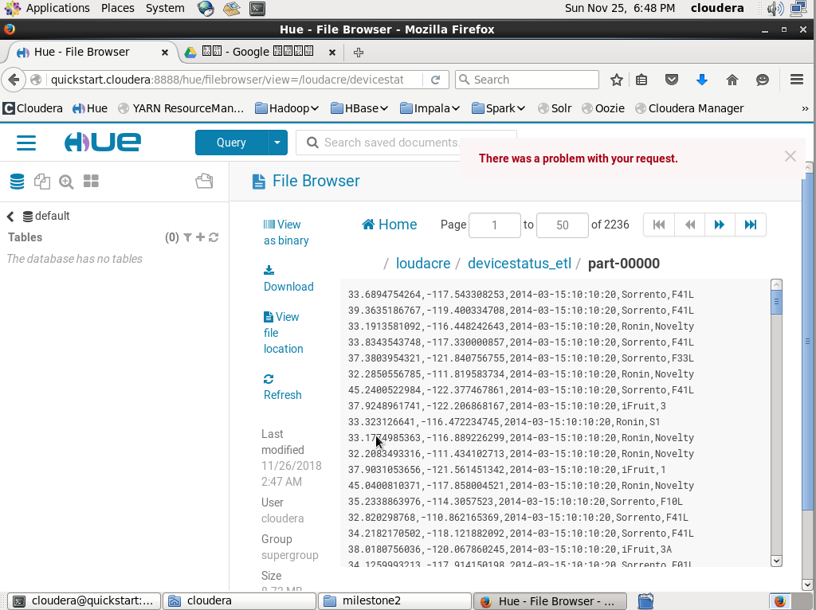
Data Preprocessing

Slide 6
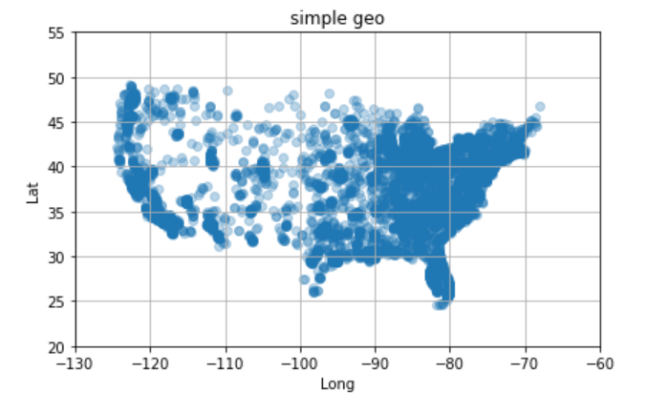
Data Visualization

Slide 7
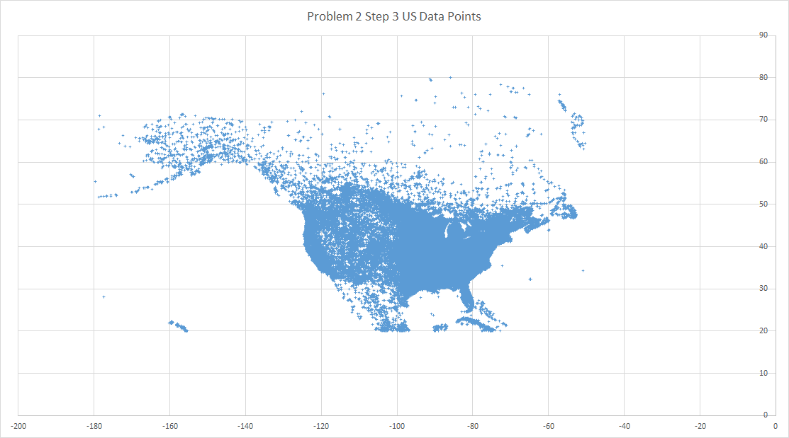
DBpedia Data
Latitude
Longitude

Slide 8
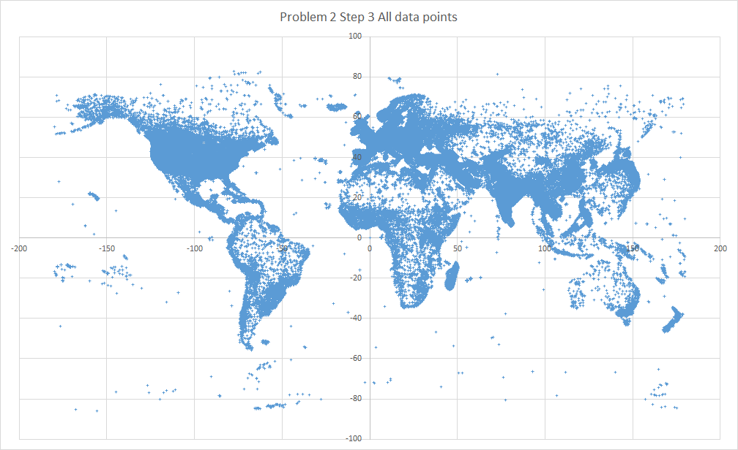
DBpedia Data
Latitude
Longitude

